Slide 1

Blazor: Bringing .NET to the Web and Beyond
Daniel Roth @danroth27
Principal Program Manager
Microsoft

Slide 2
Title
https://...

Slide 3



Angular React Vue JavaScript
https://...
JS

Slide 4


Blazor
https://...
C# language
Tooling / IDE
Consistent ecosystem
Stability
Blazor

Slide 5



How it works
Blazor Server
Blazor WebAssembly
https...
https://...
ASP.NET Core
Razor Components
DOM
SignalR
DOM
.NET
Razor Components
WebAssembly
.NET
.NET Core 3.1 LTS
Now released!

Slide 6
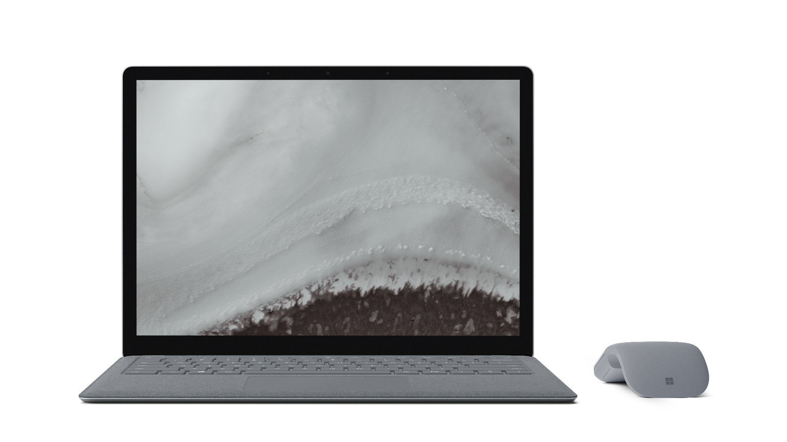
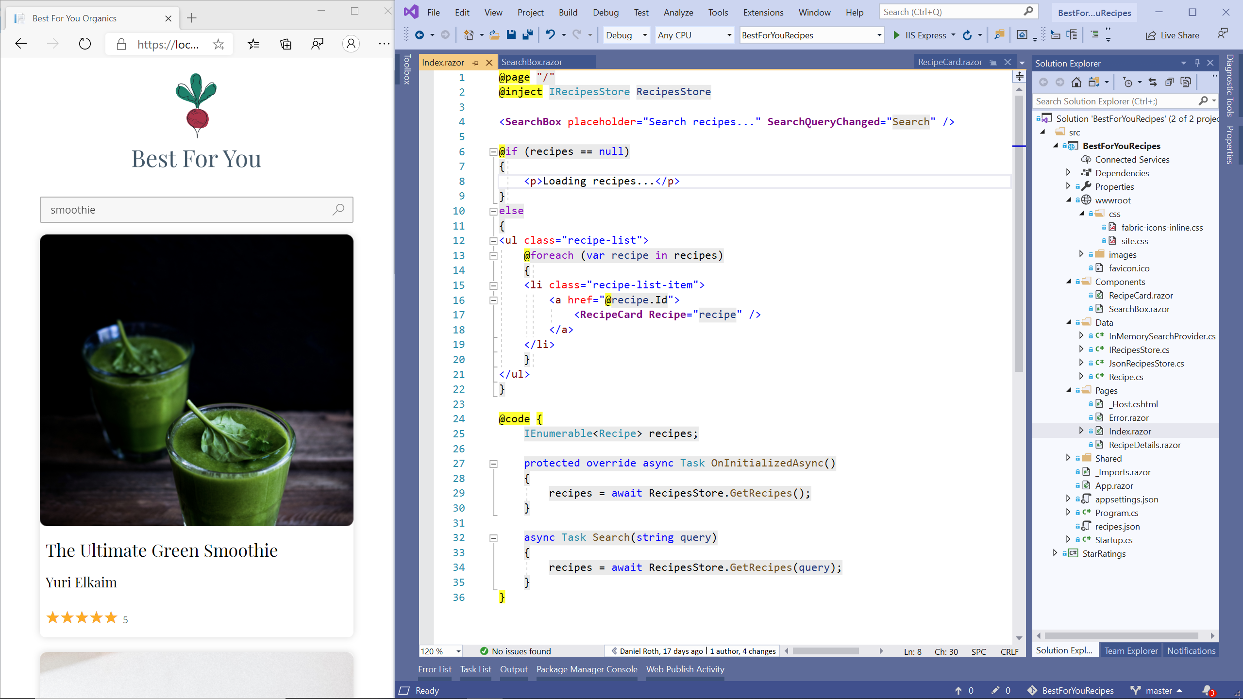
RELEASED
Blazor WebAssembly
Full-stack web development with ASP.NET Core
Run .NET natively in the browser
Create Progressive Web Apps with offline support
Now included in .NET Core 3.1 SDK
dot.net/get-core3
Also ships with Visual Studio 2019 16.6 & Visual Studio for Mac 8.6
Notes:
Blazor WebAssembly is now officially released!
Blazor is your full stack solution for building web UI with .NET and C# instead of JavaScript. Support for building Blazor apps originally shipped with .NET Core 3.1 using a server-hosted model that we call Blazor Server, where all UI interactions are handled over a real-time connection with the browser. Now, with Blazor WebAssembly, you can run your Blazor apps purely client-side using a WebAssembly-based .NET runtime. Blazor WebAssembly enables you to run .NET Standard libraries directly in the browser using just open web standards - no browser plugins or code transpilation required.

Slide 7
Blazor WebAssembly features
.NET Standard 2.1
ASP.NET Core hosted / standalone
Authentication
Progressive Web Apps
Debugging
IL trimming
Precompression
Configuration
Globalization & localization

Slide 8
Choosing your Blazor hosting model
Blazor Server
Blazor WebAssembly
https...
https://...
ASP.NET Core
Razor Components
DOM
SignalR
DOM
.NET
Razor Components
WebAssembly
.NET
.NET Core 3.1 LTS
Now released!

Slide 9
Choosing your Blazor hosting model
Blazor Server
Full access to server capabilities
Fast to startup
Code never leaves the server
Supports older browsers & thin clients
Requires persistent connection
Higher UI latency
Blazor WebAssembly
Runs fully client-side
No required server component
Host as a static site
Can execute offline
Larger download size
Slower runtime performance

Slide 10
Shared component model
Blazor Server
Blazor WebAssembly
https...
https://...
ASP.NET Core
Razor Components
DOM
SignalR
DOM
.NET
Razor Components
WebAssembly
.NET

Slide 11




Get started with Blazor
Go to https://blazor.net
Install the .NET Core SDK (3.1.300 or later)
Visual Studio
2019 16.6
Visual Studio for Mac
8.6
Visual Studio Code
+ C# extension

Slide 12
Demo: Blazor WebAssembly in action

Slide 13






Ready-made Blazor UI components
PARTNERS
Ready-made Blazor UI components
Notes:
.NET has a rich ecosystem of partners building additional tools and controls to help you build beautiful, full-featured, applications faster.
We have many partners releasing support for Blazor, Winforms, and WPF on .NET Core in their tools and controls today as well. SyncFusion, Radzen, Progress Telerik, GrapeCity, Infragistics and DevExpress all have great controls for multiple app models for .NET Core.
THANK YOU!!
<CLICK>

Slide 14







OPEN SOURCE
Thriving open source ecosystem
Ant Design Blazor
BlazorStrap
bUnit
Blazm
https://aka.ms/awesomeblazor

Slide 15
Blazor in the .NET 5
Blazor Server & Blazor WebAssembly support
Use .NET 5 core framework libraries
Component model improvements
Type constraints, required parameters, IAsyncDisposable
CSS isolation
Lazy-loading
Improved runtime & build performance
Razor tooling enhancements
And more!

Slide 16
Web
Blazor Server
Web app
Every interaction handled on server
Prerendered HTML (optional)
Blazor WebAssembly
Web app with client-side execution
Loaded from web server
Can work offline via Service Worker
Blazor PWA – OS installed
Appears as native app (own window)
Works offline or online
Blazor Hybrid
Native .NET renders to WebView
Appears as native app (own window)
Works offline or online
Desktop
+ Mobile
Blazor Native
Same programming model, but
rendering non-HTML UI

Slide 17


EXPERIMENTAL
Mobile Blazor Bindings
Build native mobile apps with Blazor
Use your familiar web skills: Razor, C#, CSS
Rich set of native mobile components
100% access to native APIs: GPS, Media, & more
Use existing ecosystem of NuGet libraries for mobile
All in .NET
aka.ms/mobile-blazor-bindings
Notes:
Blazor WebAssembly is now officially released!
Blazor is your full stack solution for building web UI with .NET and C# instead of JavaScript. Support for building Blazor apps originally shipped with .NET Core 3.1 using a server-hosted model that we call Blazor Server, where all UI interactions are handled over a real-time connection with the browser. Now, with Blazor WebAssembly, you can run your Blazor apps purely client-side using a WebAssembly-based .NET runtime. Blazor WebAssembly enables you to run .NET Standard libraries directly in the browser using just open web standards - no browser plugins or code transpilation required.

Slide 18
Demo: Blazor for native apps

Slide 19


Blazor .NET MAUI
Run Blazor components in a web view inside a .NET MAUI app
Use Blazor to define native UI
Mix & match Web & native UI
Call native APIs via System.Devices
Small & lightweight
Under investigation for .NET 6

Slide 20
In summary
Build full stack web apps with Blazor using .NET & C#
Blazor Server & Blazor WebAssembly are now released and ready for production use
Blazor in .NET 5: component model enhancements, CSS isolation, lazy-loading, improved build & runtime performance, & more
Try building native apps with the experimental Mobile Blazor Bindings

Slide 21
Resources
Home: blazor.net
Docs: blazor.net/docs
Workshop: aka.ms/blazor-workshop
Community: aka.ms/awesome-blazor
Mobile Blazor Bindings: aka.ms/mobile-blazor-bindings
.NET MAUI: aka.ms/dotnet-maui
CarChecker: aka.ms/blazor-carchecker

Slide 22
Get started with Blazor today!
https://blazor.net

Slide 23


Thanks for watching!
Questions?

Slide 24






Slide 25


